Slide 1

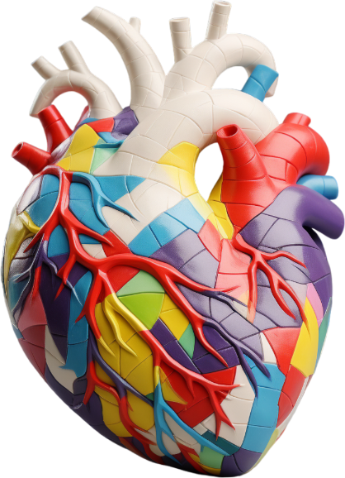
Exploring advanced techniques in predicting heart disease
Predictive Modeling of
Heart Disease
This presentation focuses on the development and evaluation of machine learning models aimed at detecting heart disease, highlighting the importance of early prediction for better patient outcomes.

Slide 2
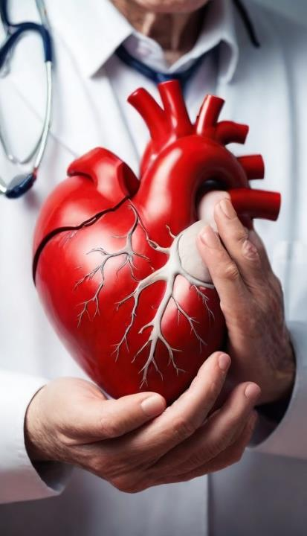
Understanding Heart Disease
Utilizes data on lifestyle, genetic predispositions, and environmental faHeart disease is a leading cause of mortality globally, affecting millions each year. Early prediction can significantly improve patient outcomes by allowing for timely interventions. By utilizing advanced predictive modeling techniques, healthcare providers can identify at-risk individuals, enabling tailored treatment plans and lifestyle changes. This proactive approach aims to reduce the incidence of heart disease and improve overall public health.
Understanding Heart Diseasectors to evaluate an individual's likelihood of developing heart disease.

Slide 3




Predictive Modeling
Regression
Analysis
Decision
Trees
Neural
Networks
Ensemble
Methods
Quantifies relationships, predicts continuous or categorical outcomes.
Splits data into branches for classification or regression.
Mimics brain structure for complex pattern recognition, prediction.
Combines multiple models for improved accuracy and stability.

Slide 4
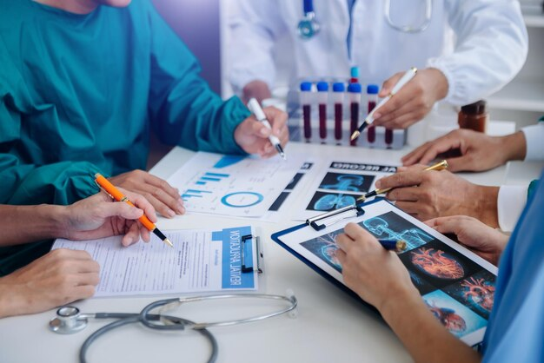
Dataset Overview
• Source: UCI Heart Disease Dataset
• Features: 14 attributes including age, sex, chest pain type, blood pressure, cholesterol, etc.
• Target: Presence or absence of heart disease
• Dataset Size: 303 samples

Slide 5
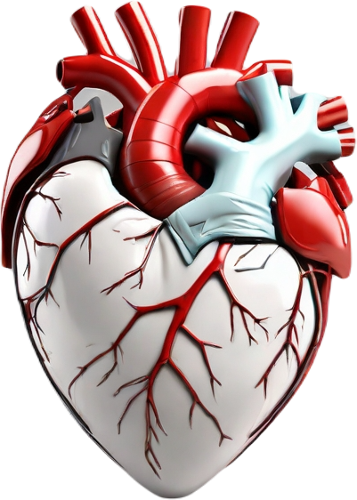
Methodology
1. Data Preprocessing:
- Handling missing values
- Feature scaling and encoding
2. Model Building:
- Logistic Regression
- Support Vector Machine
- Gradient Boosting
- Multi-layer Perceptron (PyTorch)
3. Evaluation:
- Accuracy, Precision, Recall, F1-Score, Confusion Matrix

Slide 6
Challenges & Learnings
• Challenges:
- Balancing accuracy and overfitting
- Hyperparameter tuning
• Learnings:
- Applied ML algorithms and deep learning
- Improved model evaluation and reporting
- Strengthened problem-solving and presentation skills

Slide 7
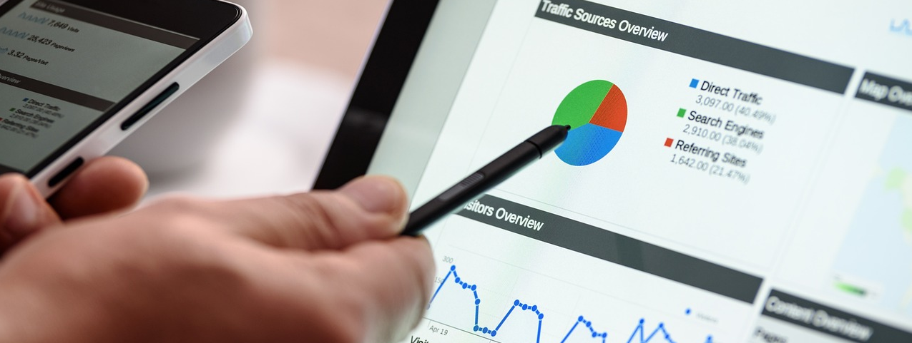
Why Me?
• Strong foundation in AI, ML, and data handling
• Passionate about health-tech solutions
• Proven ability to apply theory into impactful practice
• Committed, adaptive, and eager to contribute to the project

Slide 8
Thank You..!
Pratik Rahul Bamane
pratikrbamne@gmail.com / 7820828755

